Slide 1
LDAP Setup for Cloud Pak for Data V3.0
Sravan Khambhampati May 12 2020

Slide 2
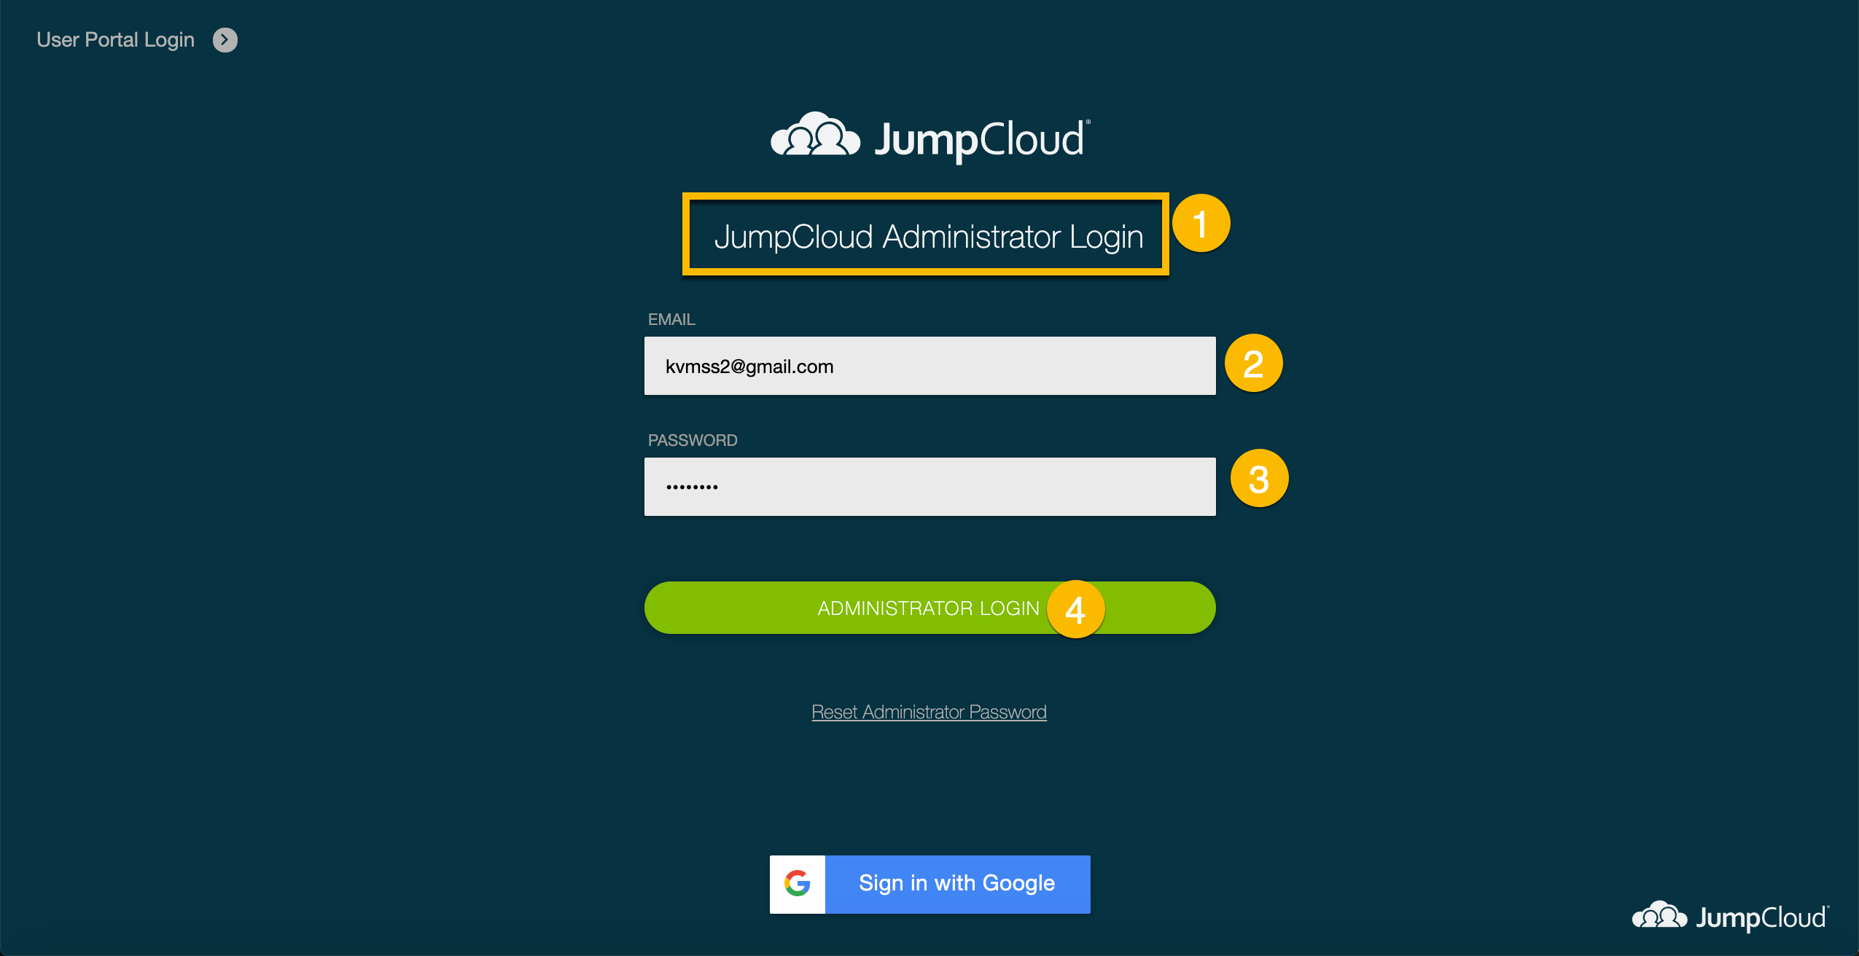
Notes:
Make sure you logged in as administrator into JumpCloud acco.

Slide 3
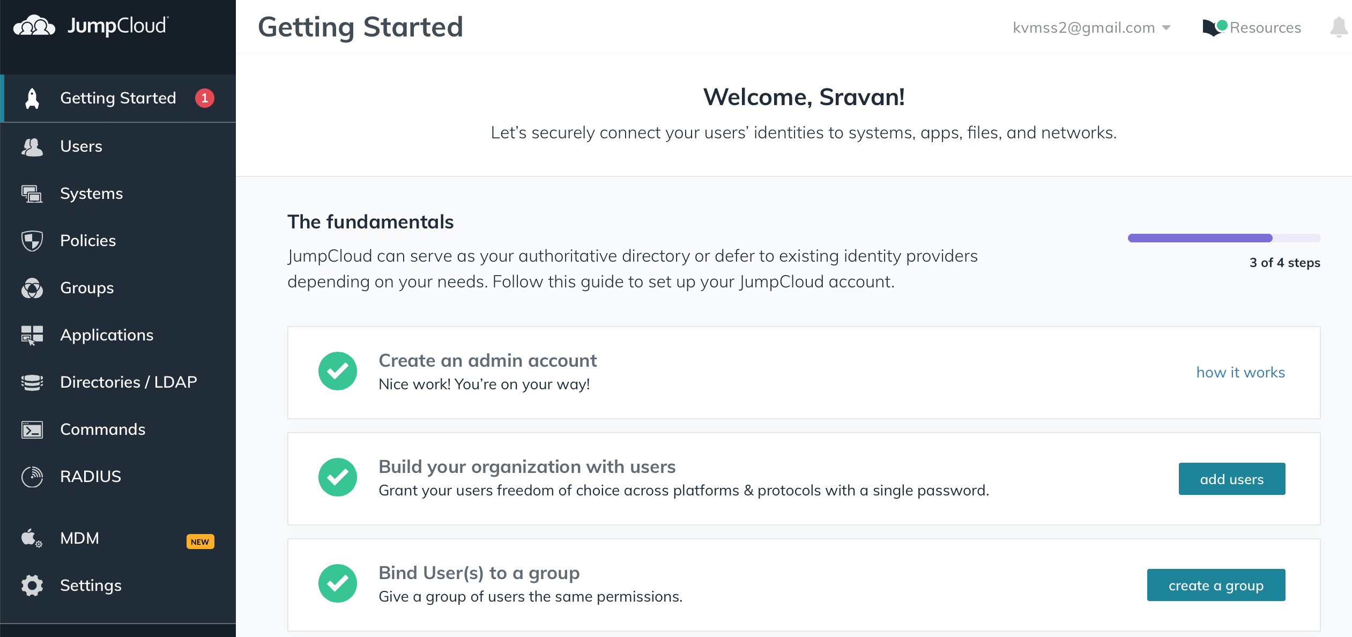
https://jumpcloud.com/
https://support.jumpcloud.com/support/s/article/using-jumpclouds-ldap-as-a-service1
Notes:
Let’s look at how to create and configure LDAP. We will be using free tier option at JumpCloud to demo.

Slide 4
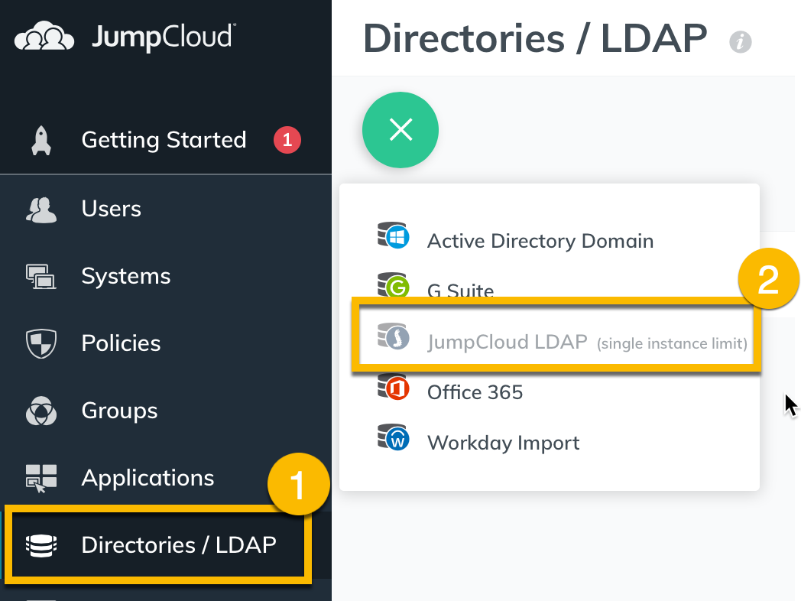
Create JumpCloud LDAP
Notes:
Create LDAP using JumpCloud option.

Slide 5
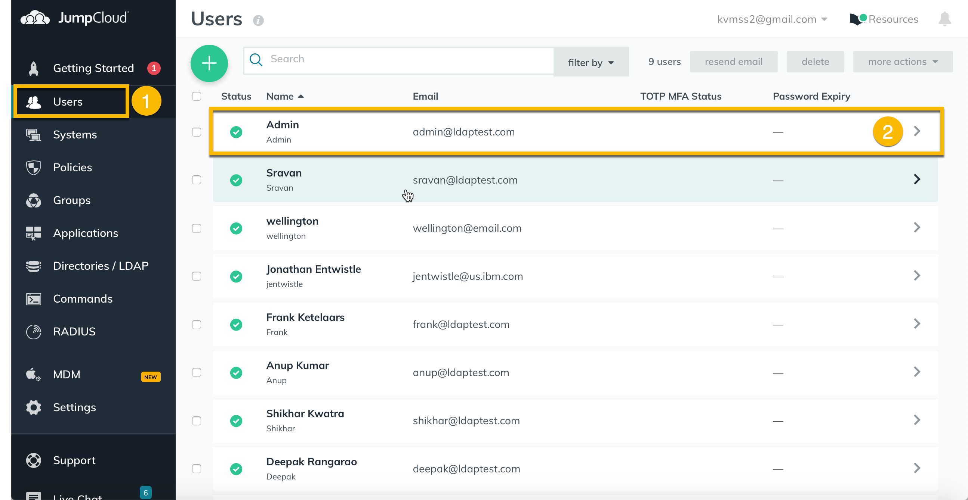
Create Users
Notes:
Create all the required users. In this picture, Lets look at Admin user which is also happen to be our Bind/Distinguished Name (DN) user.

Slide 6
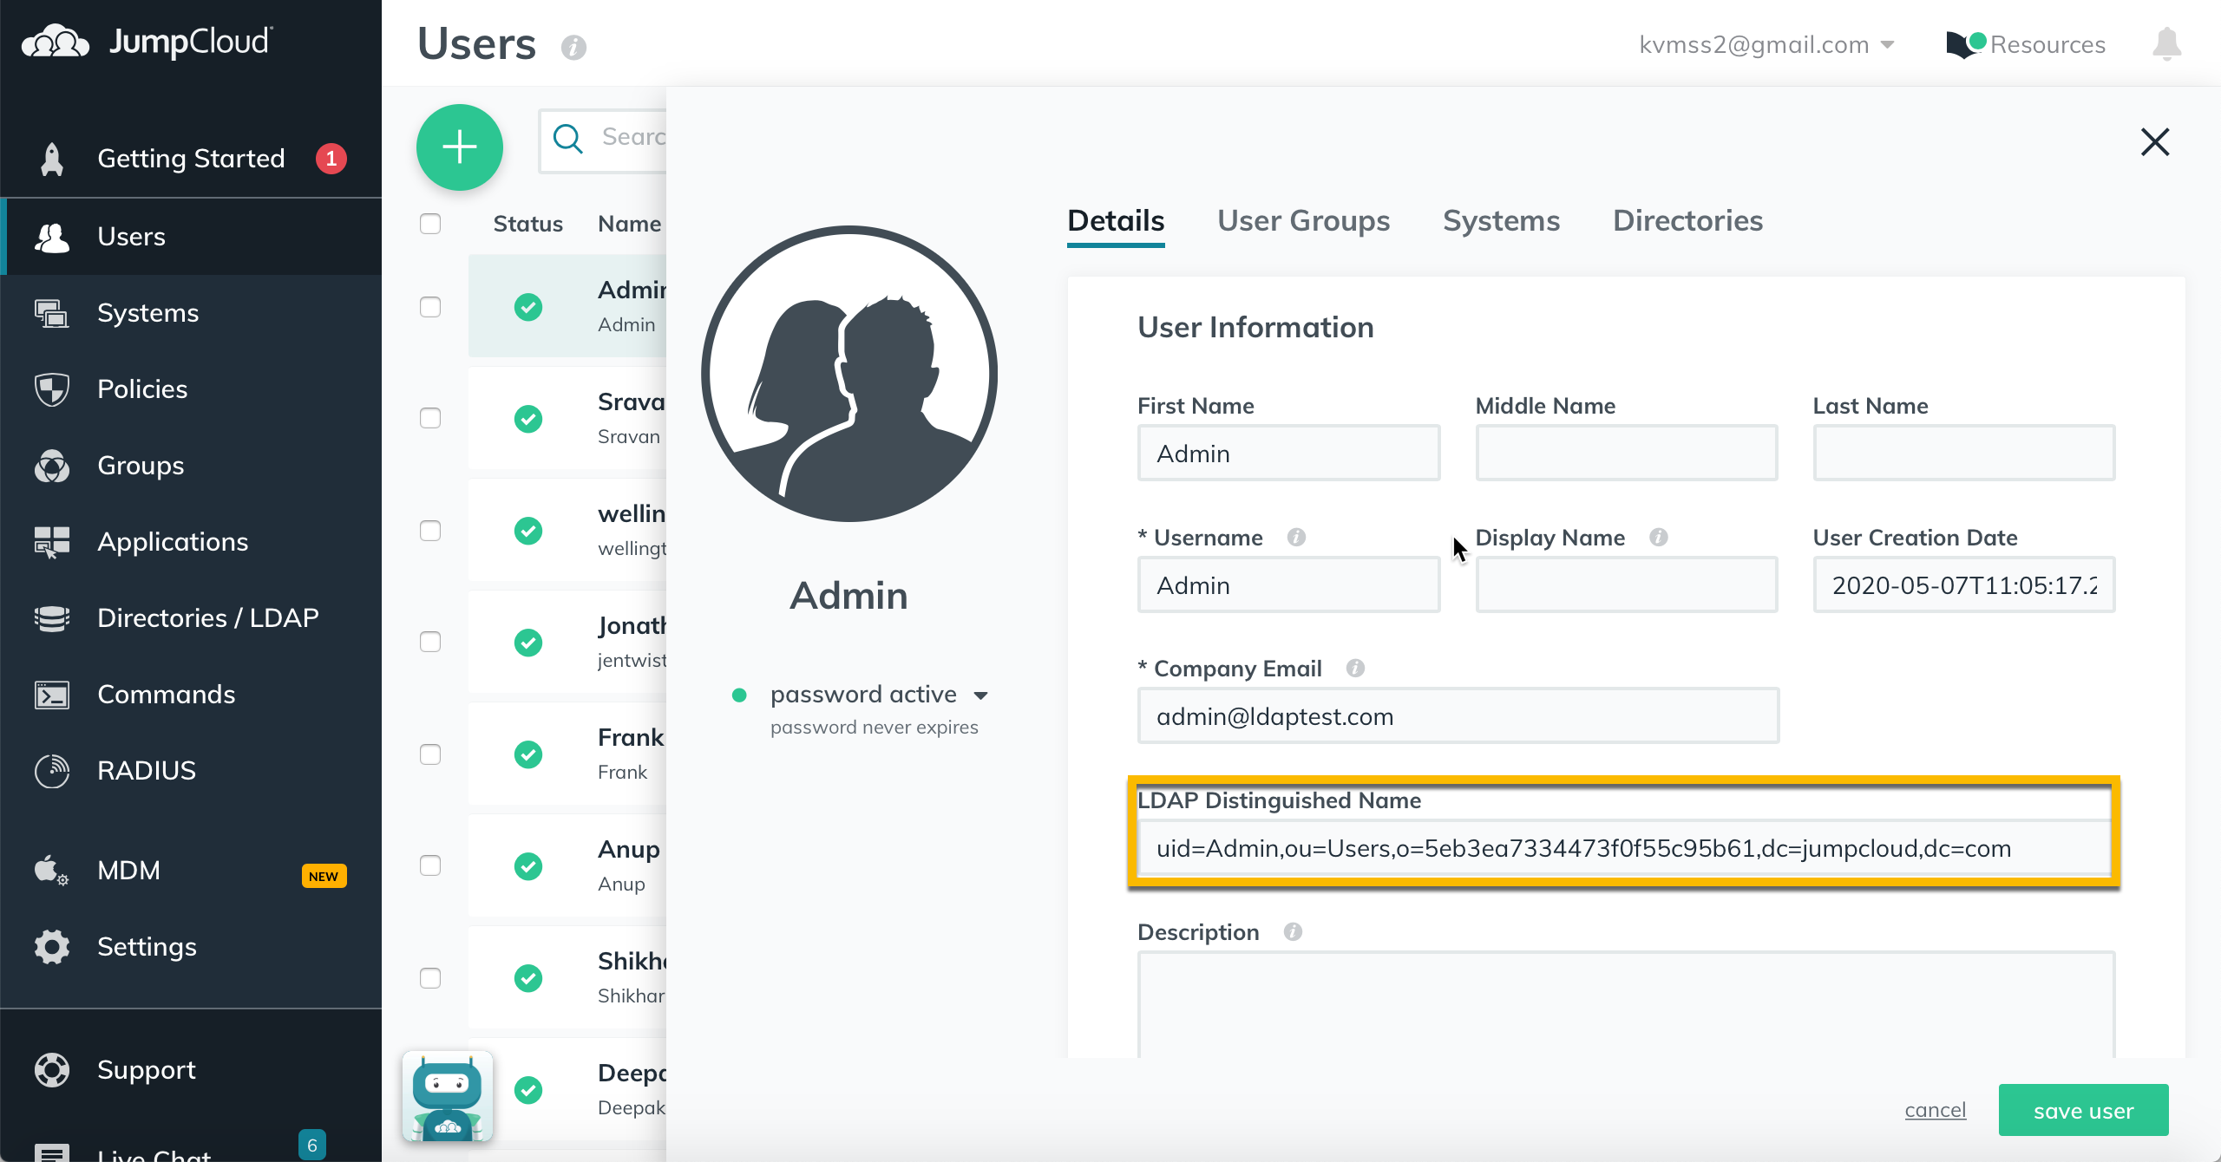
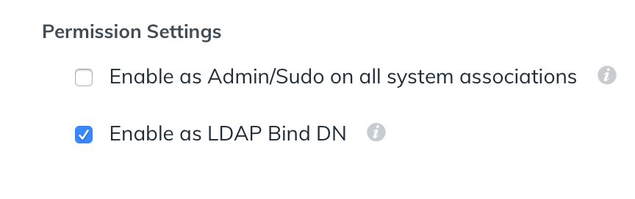
Enable Admin user as Bind DN
Notes:
Make not of the LDAP Distinguished Name this will be used for configuring LDAP in CP4D.

Slide 7
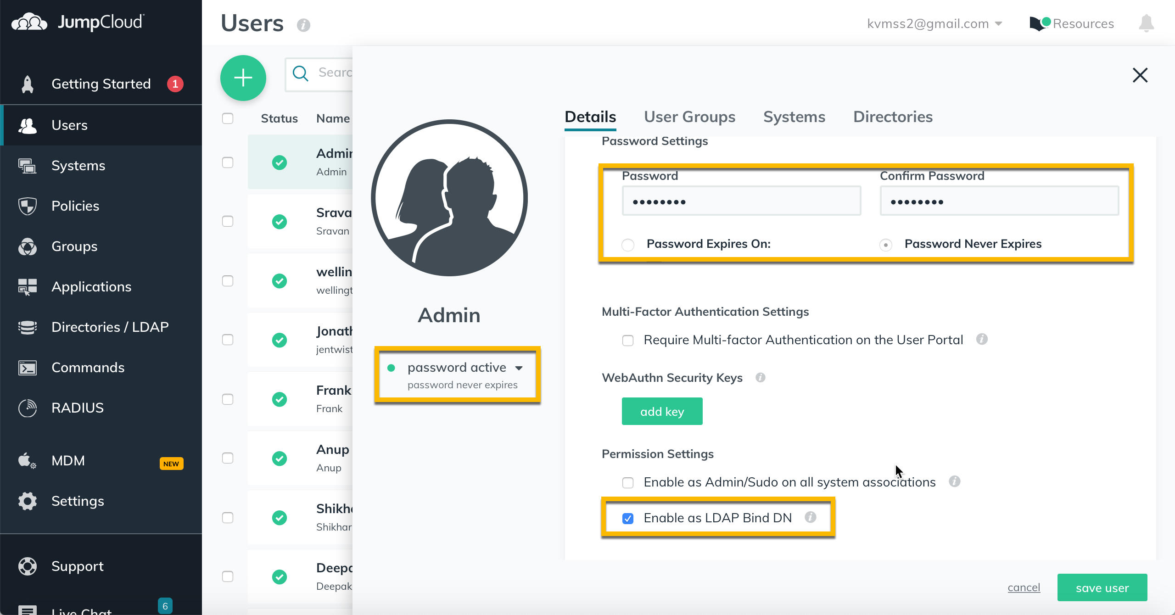
Password is set for the Bind DN
Notes:
Make sure the password is set for the admin account.
Make sure that the password is set to never expire.
Make sure to enable LDP Bind DN for Admin user(Bind user only)

Slide 8
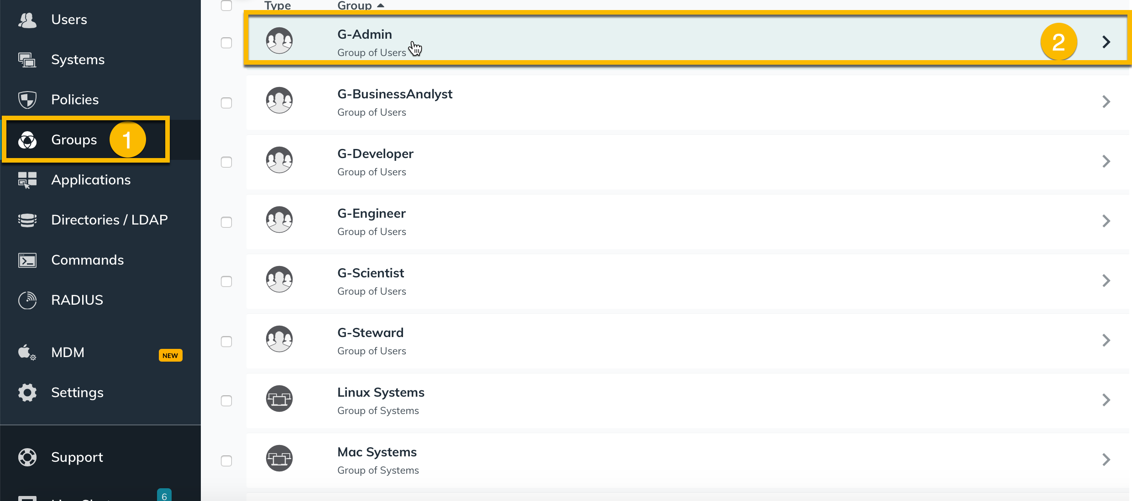
Create LDAP Groups
Notes:
Create all the groups you like to bind in CP4D.

Slide 9
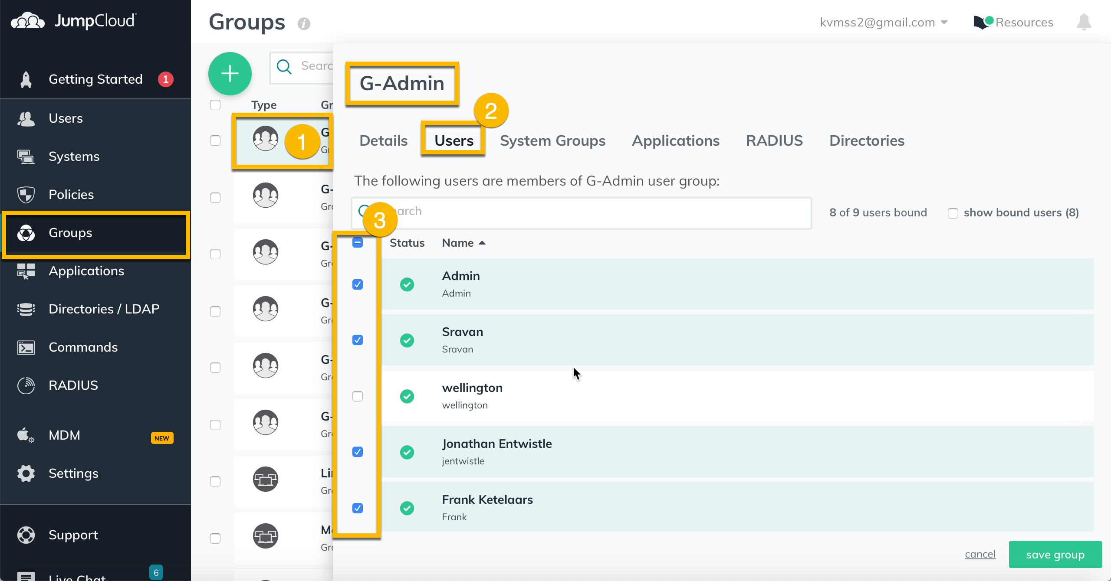
Assign user(s) to the group
Notes:
Select users that has to be part of the group. Repeat this step for every group.

Slide 10
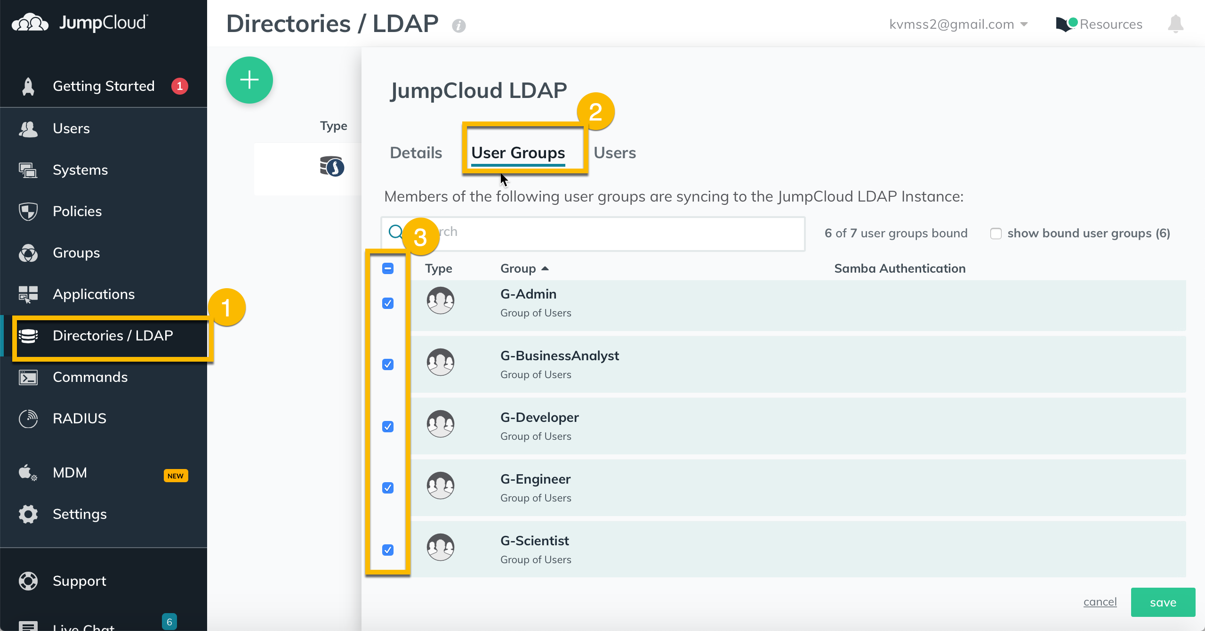
Assign Groups to LDAP
Notes:
Select groups that has to be part of the LDAP. You can also assign users directly to the LDAP.

Slide 11
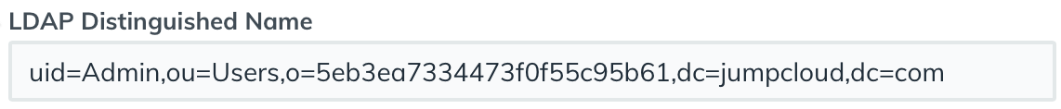
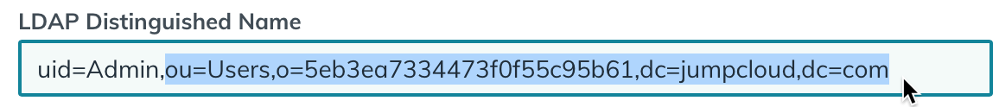
Where to get LDAP information to configure in CP4D
Run following command on command line to get additional LDAP information.
ldapsearch -x -W -D "uid=Admin,ou=Users,o=5eb3ea7334473f0f55c95b61,dc=jumpcloud,dc=com" -b "ou=Users,o=5eb3ea7334473f0f55c95b61,dc=jumpcloud,dc=com" -h ldap.jumpcloud.com -p 389
Admin user is our LDAP DN user. (Following information can be found in Admin User properties on JumpCLoud LDAP server)
Domain search base is same as above string without “uid=Admin,”
Ldap Server is ldap.jumpcloud.com in our demo.
Port 389 is unsecure port, but we will be using 636 (secure port) to configure LDAP in CP4D

Slide 12
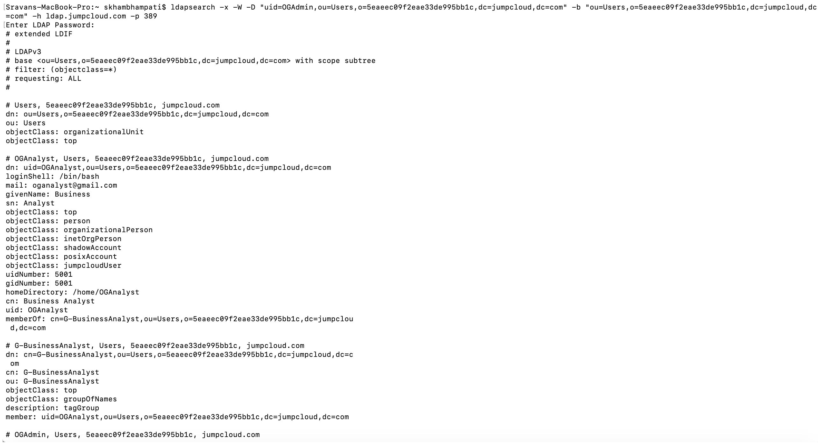
Configure LDAP in CP4D 3.0
Notes:
Run following command to get information on what to fill in the LDAP Attribute mapping.
ldapsearch -x -W -D "uid=Admin,ou=Users,o=5eb3ea7334473f0f55c95b61,dc=jumpcloud,dc=com" -b "ou=Users,o=5eb3ea7334473f0f55c95b61,dc=jumpcloud,dc=com" -h ldap.jumpcloud.com -p 389
*Please update Domain user and Domain search base before running this command.

Slide 13
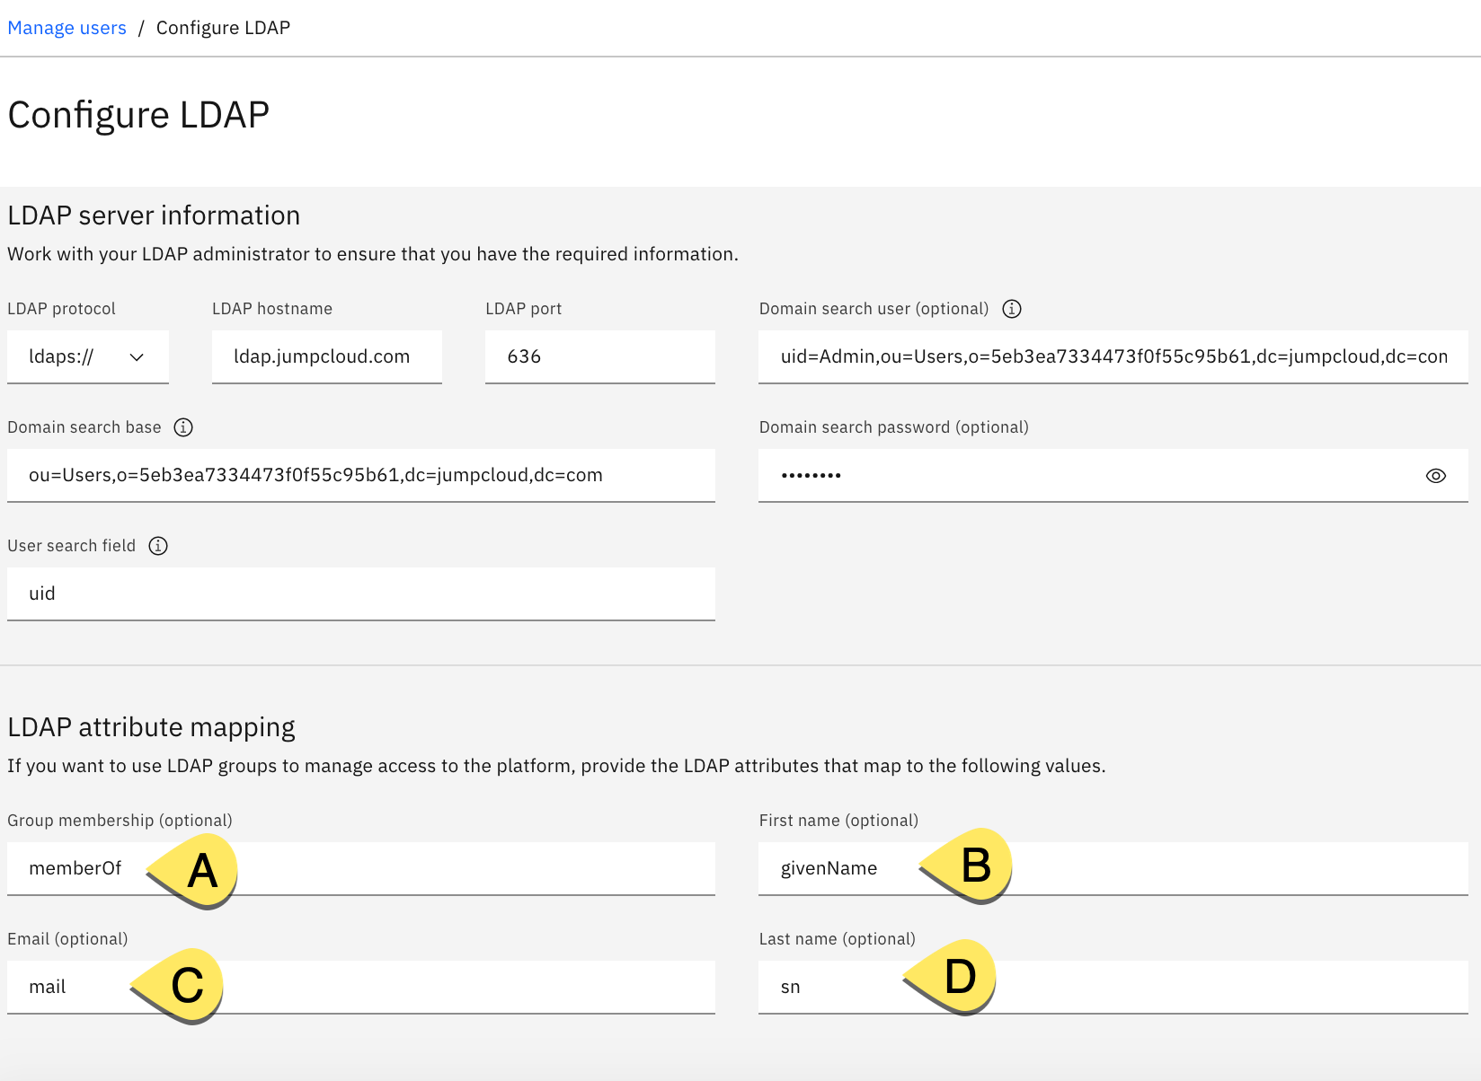
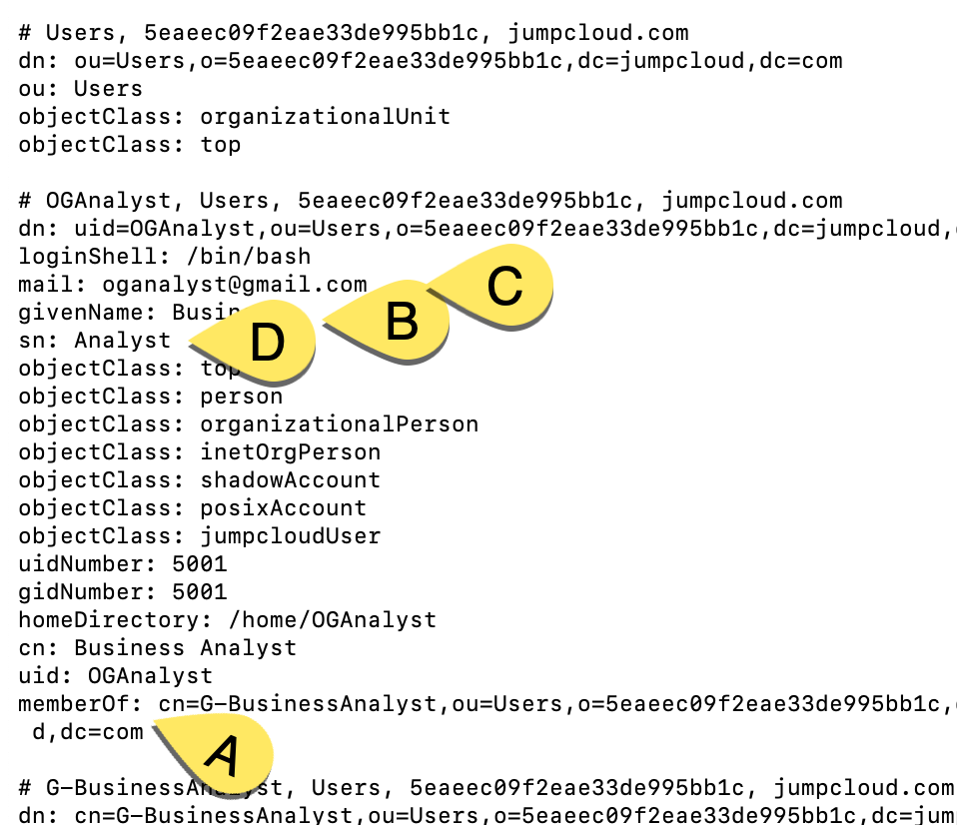
Configure LDAP in CP4D 3.0
Notes:
Run following command to get information on what to fill in the LDAP Attribute mapping.
ldapsearch -x -W -D "uid=Admin,ou=Users,o=5eb3ea7334473f0f55c95b61,dc=jumpcloud,dc=com" -b "ou=Users,o=5eb3ea7334473f0f55c95b61,dc=jumpcloud,dc=com" -h ldap.jumpcloud.com -p 389
*Please update Domain user and Domain search base before running this command.

Slide 14
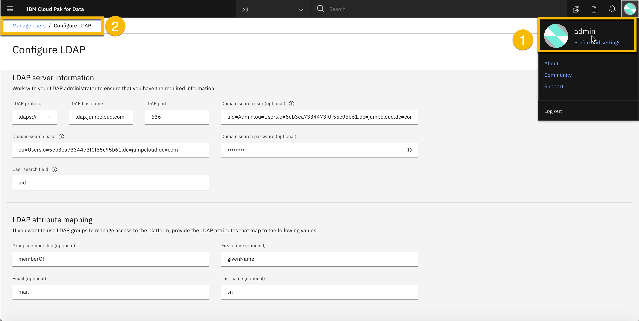
Configure LDAP in CP4D 3.0

Slide 15
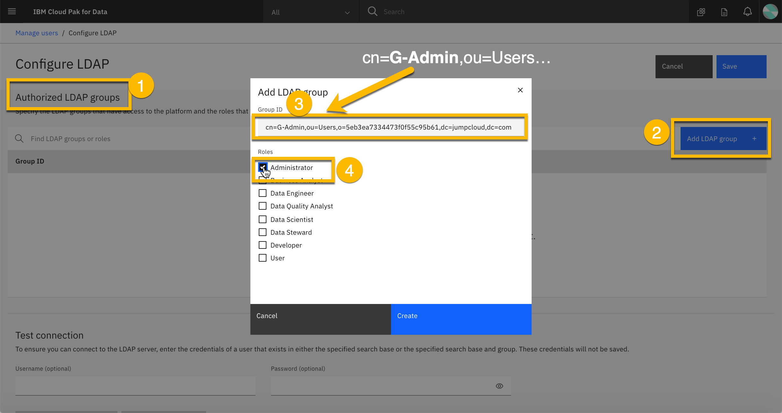
Configure Authorized LDAP Groups in CP4D 3.0

Slide 16
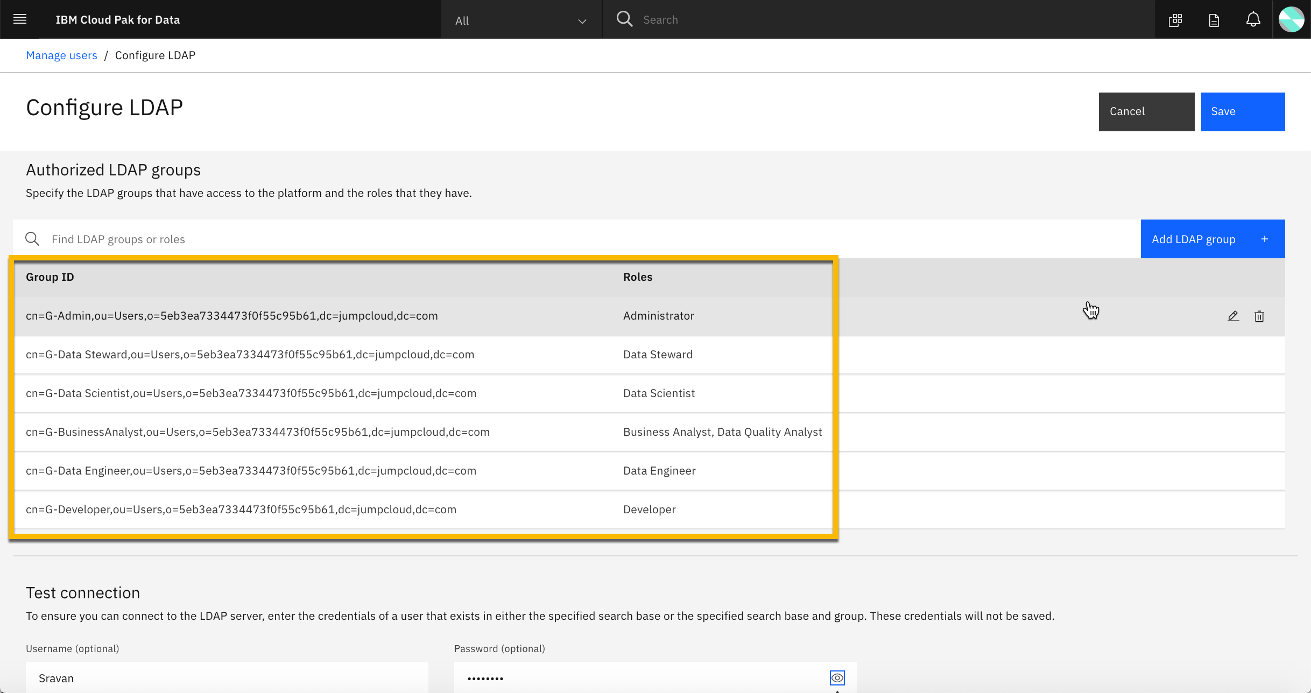
Map LDAP Groups to CP4D Roles

Slide 17
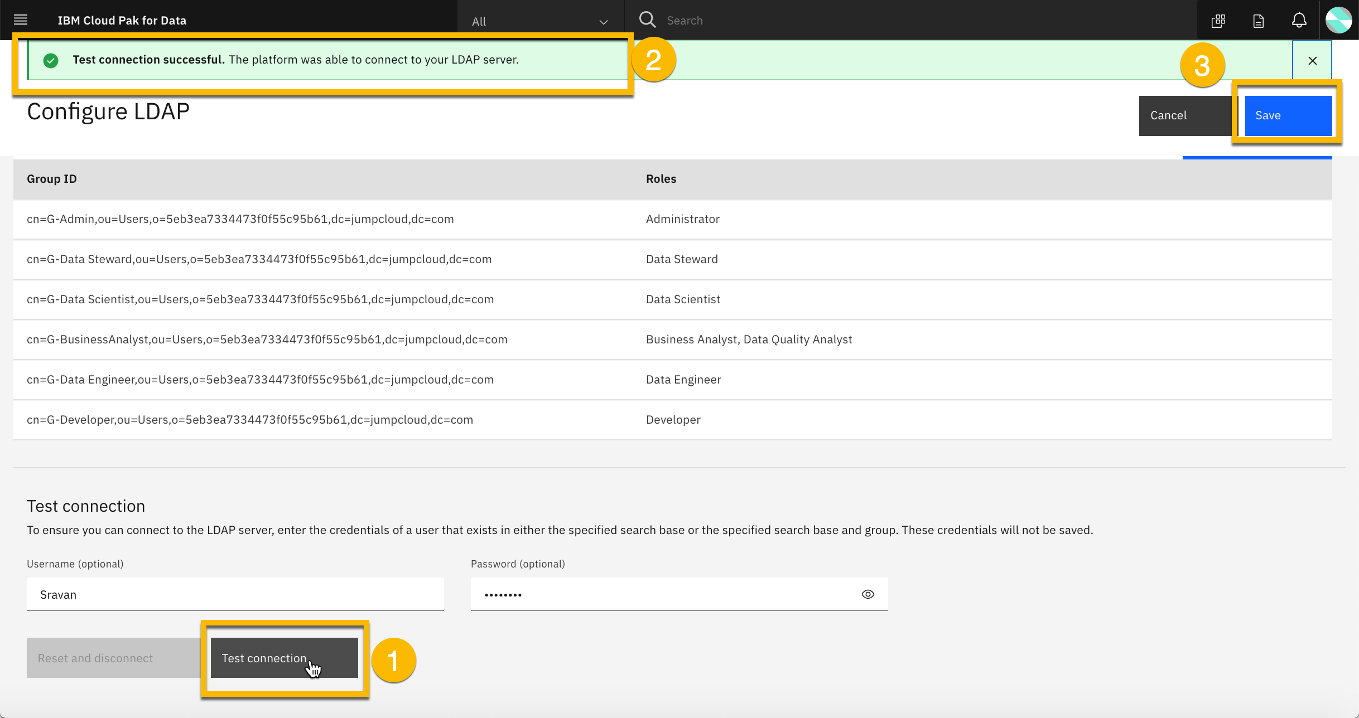
Test LDAP connection using a user from LDAP Server

Slide 18
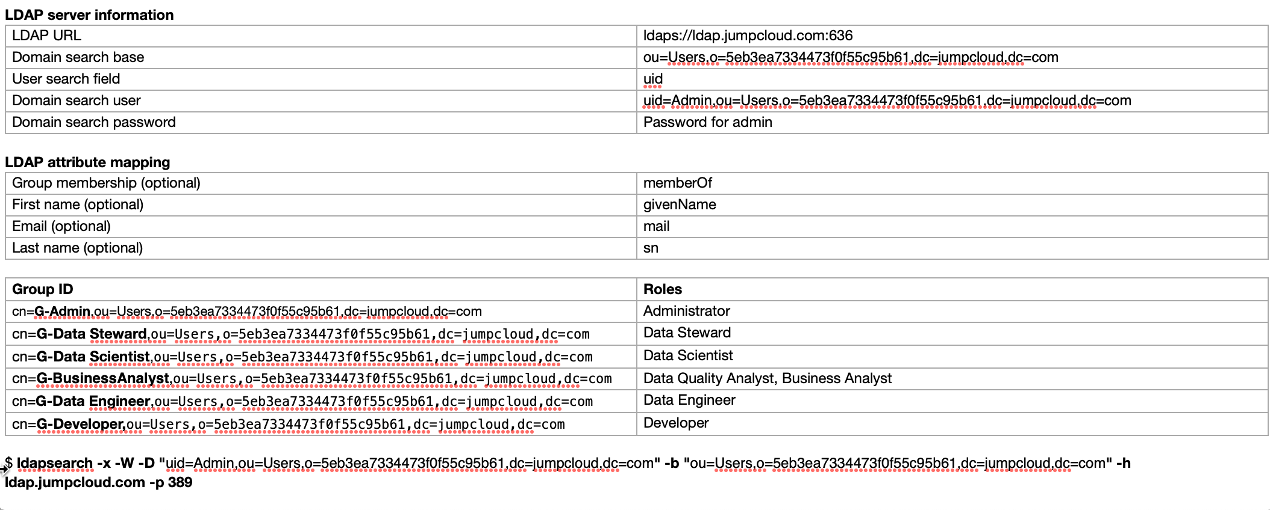
Configure LDAP in CP4D using JumpCloud

